Slide 1
Demo Day Preparation
Prof. Dr. Dirk Riehle
Friedrich-Alexander University Erlangen-Nürnberg
AMOS H01
Licensed under CC BY 4.0 International
Notes:
It is Friedrich-Alexander University Erlangen-Nürnberg – FAU, in short.
Corporate identity wants us to say “Friedrich-Alexander University”.

Slide 2
The AMOS Demo Day
The demo day is the final day of the course
  The demo day is organized as a fair (“Messe”)
  Student teams show the results of their project
  Audience are industry partners and fellow students

Slide 3
AMOS Demo Day Process
Introduction
  General introduction
  1 slide, 1 min. introduction by each team (one speaker)
Project demos
  After the introduction, we split up into the projects
  One presentation booth (in-person) / demo room (online) for each project
  At least one person from each project needs to be ready to demo
  Demo day participants (including students without booth duty) roam around
  There are five demo sessions, and sessions restart every 20 min.
Conclusion
  At the end, we come together in the main room to say goodbye

Slide 4
AMOS Demo Day Schedule
See Course organization doc, tab Demo day schedule

Slide 5
Presentation Booth / Virtual Demo Room
If held in-person
  Students are given a “presentation booth”
  The booth is a table plus pinboards
  Students demo their work at this table
  Students explain their work using the posters
  Students can create additional materials
If held online
  Students create a virtual demo room
  Students provide a back-up video
  Students demo their work in this room
  Students explain their work using slides
  Students can create additional materials

Slide 6
Demo Posters / Slide Deck
If held in-person
  One product management poster with
    Project and team name, team logo
    Short project description
    Key use cases
  One software development poster with
    Software architecture
    Employed technology
    Tooling and processes
  These are exact requirements
    We will print the posters
If held online
  A slide deck with
    One product management slide
    One software development slide
    One team photo slide (can be screenshot)
    Slide content like the in-person posters
  These are minimum requirements
    You can do more if you like
  What happens in the demo room
    Stays in the demo room
    The slides are not deliverables

Slide 7
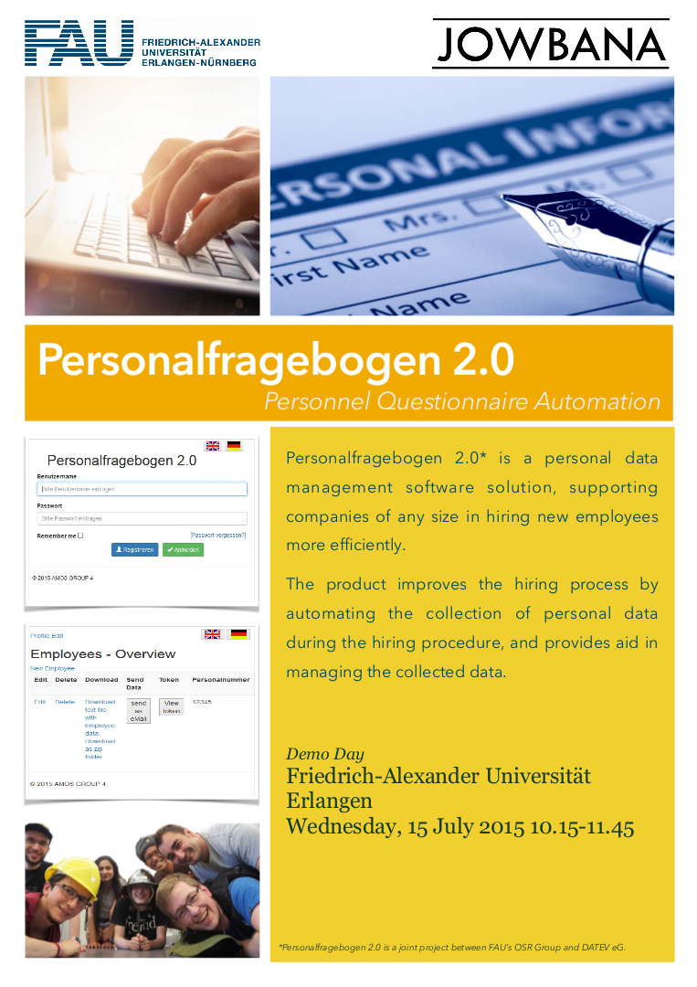
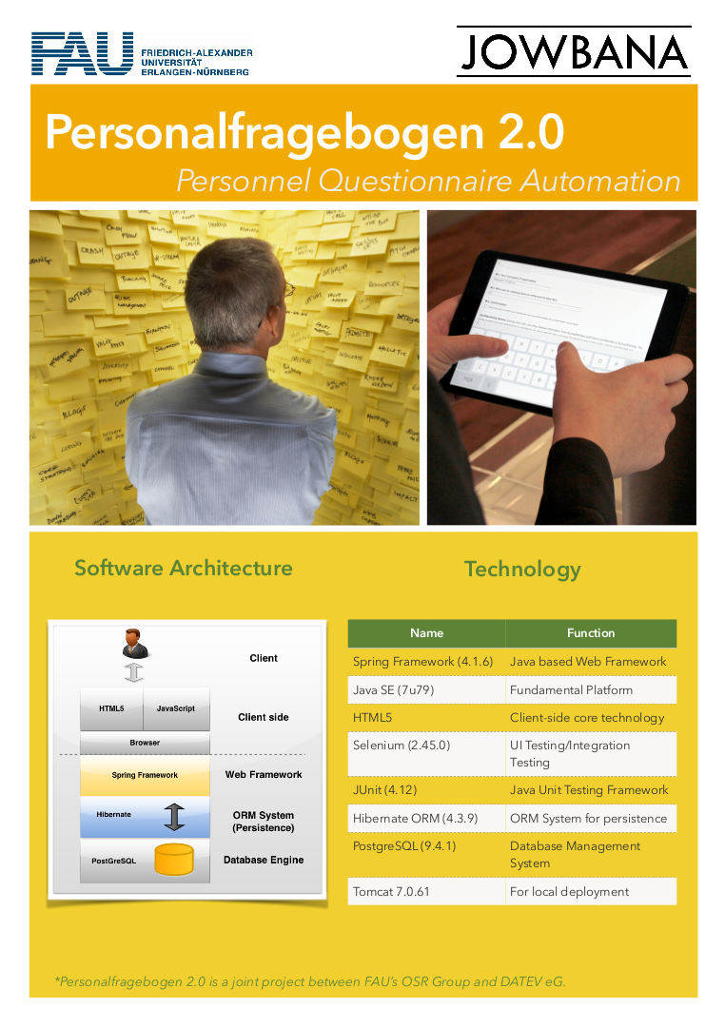

Slide 8
Use of Corporate Identities
Please use university logo
Please use your team logo
Please use industry partner logo, but ask first

Slide 9
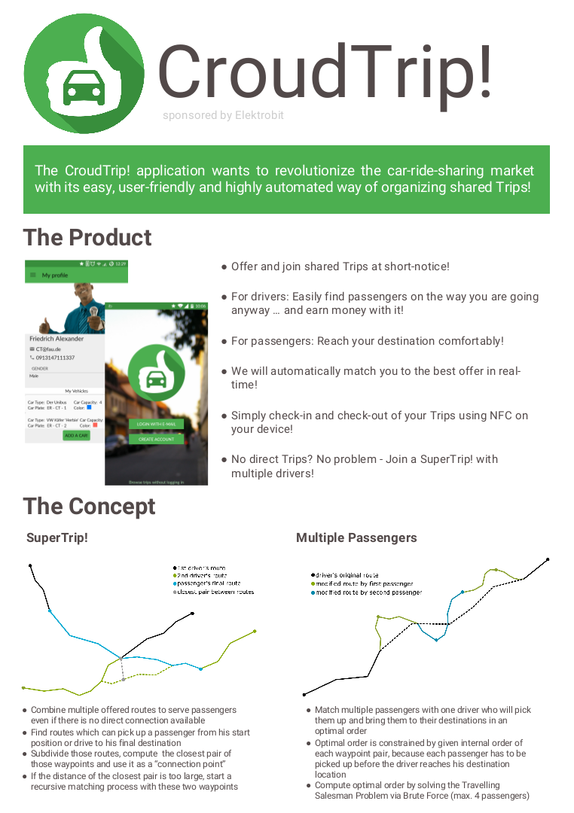
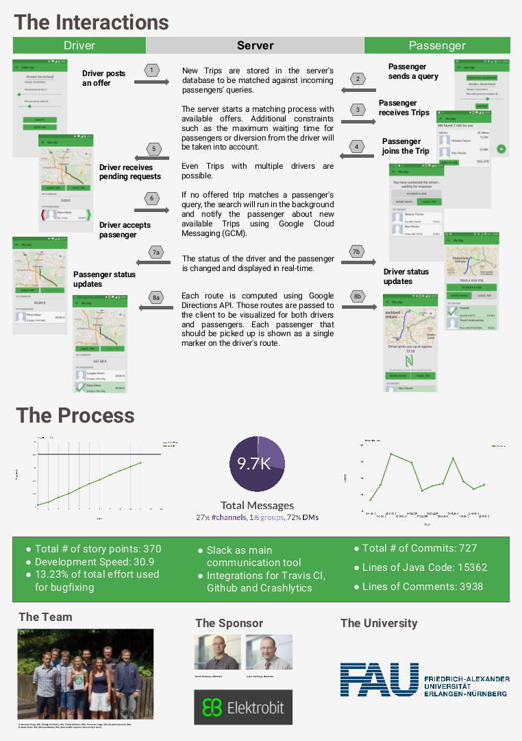

Slide 10
Presentation Table
If held in-person
  Mandatory
    Bring a laptop to demo your project
    Bring anything else necessary
  Optional
    Be creative, do what works!
    The goal is to explain your project
If held online
  Prepare for online presentation

Slide 11
Demo Preparation
Dos
  Have a clean user interface
  Use domain terminology and examples
    In the user interface (labels, titles)
    In the stories you tell
  Have a story to tell, for example,
    A day in the life of …
    A workflow example
  Make the demo (data) re-entrant
    You will have to start over several times
    You always want to start at the same point
Don’ts
  Use “test” or “help” as labels
  Not follow the advice on the left

Slide 12
Demo Execution
Have two people at the presentation booth / virtual demo room
  One talks to people in general
  One demos to people

Slide 13
Thank you! Questions?
dirk.riehle@fau.de – https://oss.cs.fau.dedirk@riehle.org – https://dirkriehle.com – @dirkriehle
DR

Slide 14
Legal Notices
License
  Licensed under the CC BY 4.0 International license
Copyright
  © 2010-2022 Dirk Riehle, some rights reserved

